Slide 1

L32
Allocation methods
Free space management
Disk Structure
Presented by:
Veena K M
OS Teacher for IV IT A
9845714070
veena.gv@manipal.edu

Slide 2
Allocation methods

Slide 3
Allocation methods
The allocation methods define how the files are stored in the disk blocks
There are three main disk space or file allocation methods.
Contiguous Allocation
Linked Allocation
Indexed Allocation
All the three methods have their own advantages and disadvantages
The main idea behind these methods is to provide:
Efficient disk space utilization.
Fast access to the file blocks

Slide 4
Allocation methods 1. Contiguous Allocation
Each file occupies a contiguous set of blocks on the disk.
For example, if a file requires n blocks and is given a block b as the starting location, then the blocks assigned to the file will be: b, b+1, b+2,……b+n-1
Given the starting block address and the length of the file (in terms of blocks required), we can determine the disk blocks occupied by the file.

Slide 5
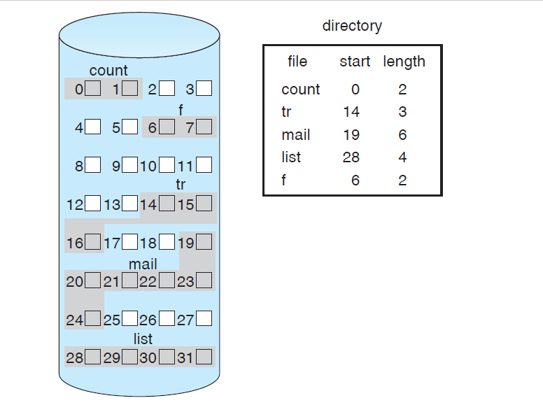
Allocation methods 1. Contiguous Allocation
The file ‘list’ in the following figure starts from the block 28 with length = 4 blocks.
Therefore, it occupies disk blocks: 28, 29, 30 and 31

Slide 6
Allocation methods 1. Contiguous Allocation
Advantages:
Both the Sequential and Direct Accesses are supported.
For direct access, the address of the k^{th} block of the file which starts at block b can easily be obtained as (b+k).
This is extremely fast since the number of seeks are minimal because of contiguous allocation of file blocks.
Disadvantages:
This method suffers from both internal and external fragmentation. This makes it inefficient in terms of memory utilization
Increasing file size is difficult because it depends on the availability of contiguous memory at a particular instance.

Slide 7
Allocation methods 2. Linked List Allocation
Each file is a linked list of disk blocks which need not be contiguous.
The disk blocks can be scattered anywhere on the disk.
The directory entry contains a pointer to the starting and the ending file block.
Each block contains a pointer to the next block occupied by the file.

Slide 8
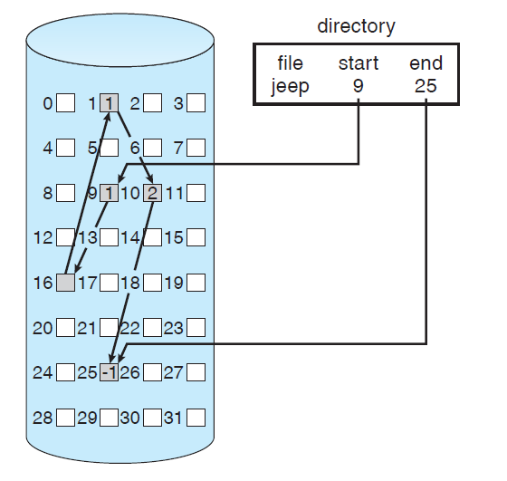
Allocation methods 2. Linked List Allocation
The file ‘jeep’ in image shows how the blocks are randomly distributed.
The last block (25) contains -1 indicating a null pointer and does not point to any other block.

Slide 9
Allocation methods 2. Linked List Allocation
Advantages:
very flexible in terms of file size.
File size can be increased easily as it is non-contiguous allocation
Does not suffer from external fragmentation.
Memory is well utilized
Disadvantages:
a large number of seeks are needed to access every block individually
This makes linked allocation slower.
It does not support random or direct access. A block k of a file can be accessed by traversing k blocks sequentially (sequential access) from the starting block of the file via block pointers.
Pointers required in the linked allocation are extra overhead

Slide 10
Allocation methods 3. Indexed Allocation
a special block known as the Index block contains the pointers to all the blocks occupied by a file.
Each file has its own index block.
The i^{th} entry in the index block contains the disk address of the i^{th} file block.
The directory entry contains the address of the index block

Slide 11
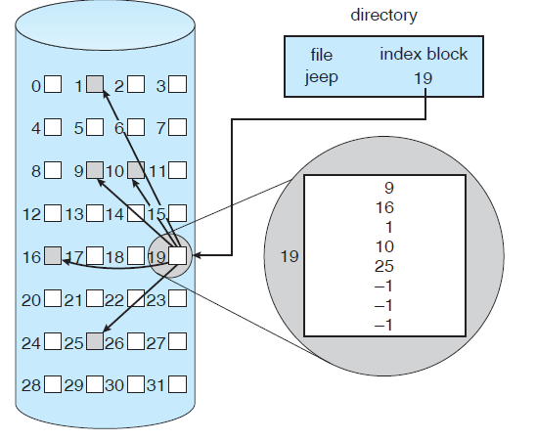
Allocation methods 3. Indexed Allocation
19th disk block is used as index block by the file ‘jeep’
The jeep uses 5 different blocks and one single index block
The unused entries in the index block stores -1 (which is NULL)

Slide 12
Allocation methods 3. Indexed Allocation
Advantages:
This supports direct access to the blocks occupied by the file and therefore provides fast access to the file blocks.
It overcomes the problem of external fragmentation.
Disadvantages:
The pointer overhead for indexed allocation is greater than linked allocation.
For very small files, say files that expand only 2-3 blocks, the indexed allocation would keep one entire block (index block) for the pointers which is inefficient in terms of memory utilization.
However, in linked allocation we lose the space of only 1 pointer per block.

Slide 13
Free Space Management

Slide 14
Free space management
The system must keep track of the free disk blocks
for allocating space to files when they are created.
to reuse the space released from deleting the files
The system maintains a free space list which keeps track of the disk blocks that are not allocated to some file or directory.
The free space list can be implemented mainly as:
Bitmap or Bit vector
Linked List
Grouping
Counting

Slide 15
Free space management
Bitmap or Bit vector
A Bitmap or Bit Vector is series or collection of bits where each bit corresponds to a disk block
The bit can take two values: 0 and 1: 0 indicates that the block is allocated and 1 indicates a free block
For example, consider a disk where blocks 2, 3, 4, 5, 8, 9, 10, 11, 12, 13, 17, 18, 25, 26, and 27 are free and the rest of the blocks are allocated. The free-space bit map would be 001111001111110001100000011100000 ...

Slide 16
Free space management 1. Bitmap or Bit vector
Advantages
Simple to understand.
Finding the first free block is efficient. It requires scanning the words (a group of 8 bits) in a bitmap for a non-zero word. (A 0-valued word has all bits 0). The first free block is then found by scanning for the first 1 bit in the non-zero word.
Unfortunately, bit vectors are inefficient unless the entire vector is kept in main memory

Slide 17
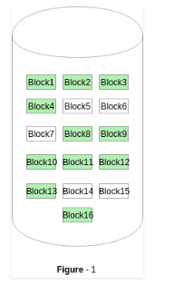
Free space management 1. Bitmap or Bit vector
The block number can be calculated as:
(number of bits per word) *(number of 0-valued words) + offset of bit first bit 1 in the non-zero word
The given instance of disk blocks on the disk in Figure 1 (where green blocks are allocated) can be represented by a bitmap of 16 bits as: 0000111000000110.
For the Figure-1, we scan the bitmap sequentially for the first non-zero word.
The first group of 8 bits (00001110) constitute a non-zero word since all bits are not 0.
After the non-0 word is found, we look for the first 1 bit.
This is the 5th bit of the non-zero word. So, offset = 5.
Therefore, the first free block number = 8*0+5 = 5.

Slide 18
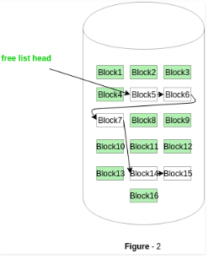
Free space management 2. Linked List –
The free disk blocks are linked together i.e. a free block contains a pointer to the next free block.
The block number of the very first disk block is stored at a separate location on disk and is also cached in memory.
In Figure-2, the free space list head points to Block 5 which points to Block 6, the next free block and so on.
The last free block would contain a null pointer indicating the end of free list.
This scheme is not efficient; to traverse the list, we must read each block, which requires substantial I/O time.

Slide 19
Free space management
3. Grouping
This approach stores the address of the free blocks in the first free block.
The first free block stores the address of some, say n free blocks.
Out of these n blocks, the first n-1 blocks are actually free and the last block contains the address of next free n blocks.
An advantage of this approach is that the addresses of a group of free disk blocks can be found easily.

Slide 20
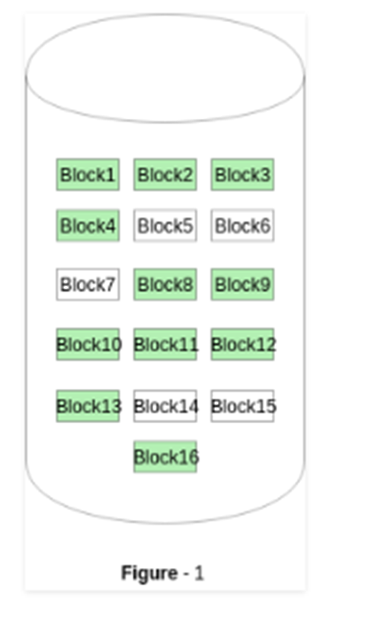
Free space management
4. Counting –
This approach stores the address of the first free disk block and a number n of free contiguous disk blocks that follow the first block.
Every entry in the list would contain:
Address of first free disk block
A number n
For example, in Figure-1, the first entry of the free space list would be: ([Address of Block 5], 2), because 2 contiguous free blocks follow block 5.

Slide 21
Disk Structure

Slide 22
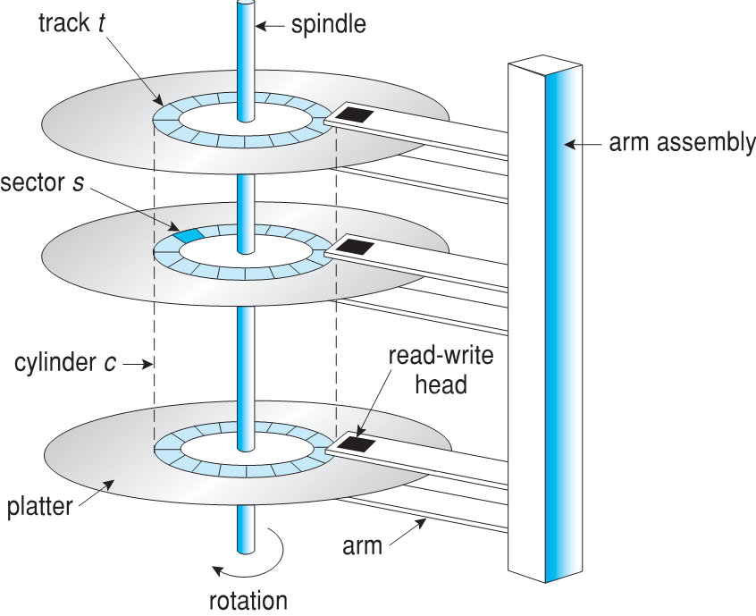
Disk Structure
Disk drives are addressed as large 1-dimensional arrays of logical blocks
The logical block is the smallest unit of transfer, usually 512 bytes
The array of logical blocks is mapped into the sectors of the disk sequentially
Sector 0 is the first sector of the first track on the outermost cylinder
Mapping proceeds in order through that track, then the rest of the tracks in that cylinder, and then through the rest of the cylinders from outermost to innermost
Moving-head disk mechanism

Slide 23
The disk is divided into tracks.
Each track is further divided into sectors.
The point to be noted here is that outer tracks are bigger in size than the inner tracks but they contain the same number of sectors and have equal storage capacity.
This is because the storage density is high in sectors of the inner tracks where as the bits are sparsely arranged in sectors of the outer tracks.
Some space of every sector is used for formatting. So, the actual capacity of a sector is less than the given capacity.

Slide 24
Read-Write(R-W) head moves over the rotating hard disk.
It is this Read-Write head that performs all the read and write operations on the disk and hence, position of the R-W head is a major concern.
To perform a read or write operation on a memory location, we need to place the R-W head over that position.
Some important terms must be noted here:
Seek time: The time taken by the R-W head to reach the desired track from it’s current position.
Rotational latency: Time taken by the sector to come under the R-W head.
Data transfer time: Time taken to transfer the required amount of data. It depends upon the rotational speed.
Controller time: The processing time taken by the controller.
Average Access time: seek time + Rotational latency + data transfer time + controller time.

Slide 25
End of L32 THANK YOU

